Slide 1
“Carcass” App
By Mathias Wöß
(k11709064)

Slide 2
Scenario 1
You are on the way to a party and in a hurry.
You are seeing a dead hedgehog laying on the side of the street.
You don’t want to call somewhere to report it right now.
You are not ready to put it away yourself, but would like it to be taken care of.
You report it in this app anonymously and volunteers/authorities will know about it.

Slide 3
Scenario 2
You drive to work in your car.
You see a dead deer in front of you on the road.
You want to warn other drivers about it.
You stop and report it in this app.
Other people using it will know about this danger.
Authorities receive this data and will put it away.

Slide 4
App idea
An app where people can report animal carcasses
Using GPS you can report it’s location
Other users can inform themselves about dead animals in their path
Authorities or volunteers check the data and get rid of the bodies
After removal the map marker should vanish for everybody
It should be anonymous - no tracking or responsibility
Possibility to add and view an optional picture
Specifying the type of animal should be required

Slide 5
Targets
Fast and modern reporting and removal of carcasses
Eliminate smells in local neighborhoods
Avoid unpleasant sightings
Driver safety with clear roads
Avoid accidents
Partnership with responsible authorities
Keep people informed
Not needing to call somewhere or go to a website to report a carcass

Slide 6
Requirements
Mobile Application using GPS and Camera
Database for all carcass locations (possibly Firebase)
Automatically updating the UI when new locations are reported
Seeing the map and your own location (Google Maps integration)
Possibility to get information about the map marker
  Type of animal
  Photo
  Remarks
  Time of reporting
No account login

Slide 7
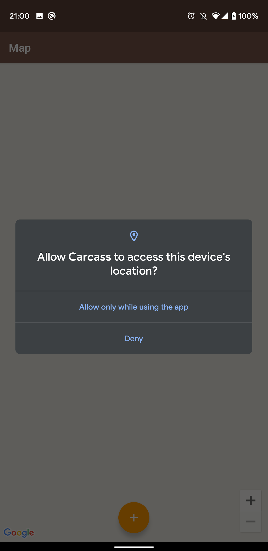
First sketch
Before entering the system
ask the user for location permissions

Slide 8
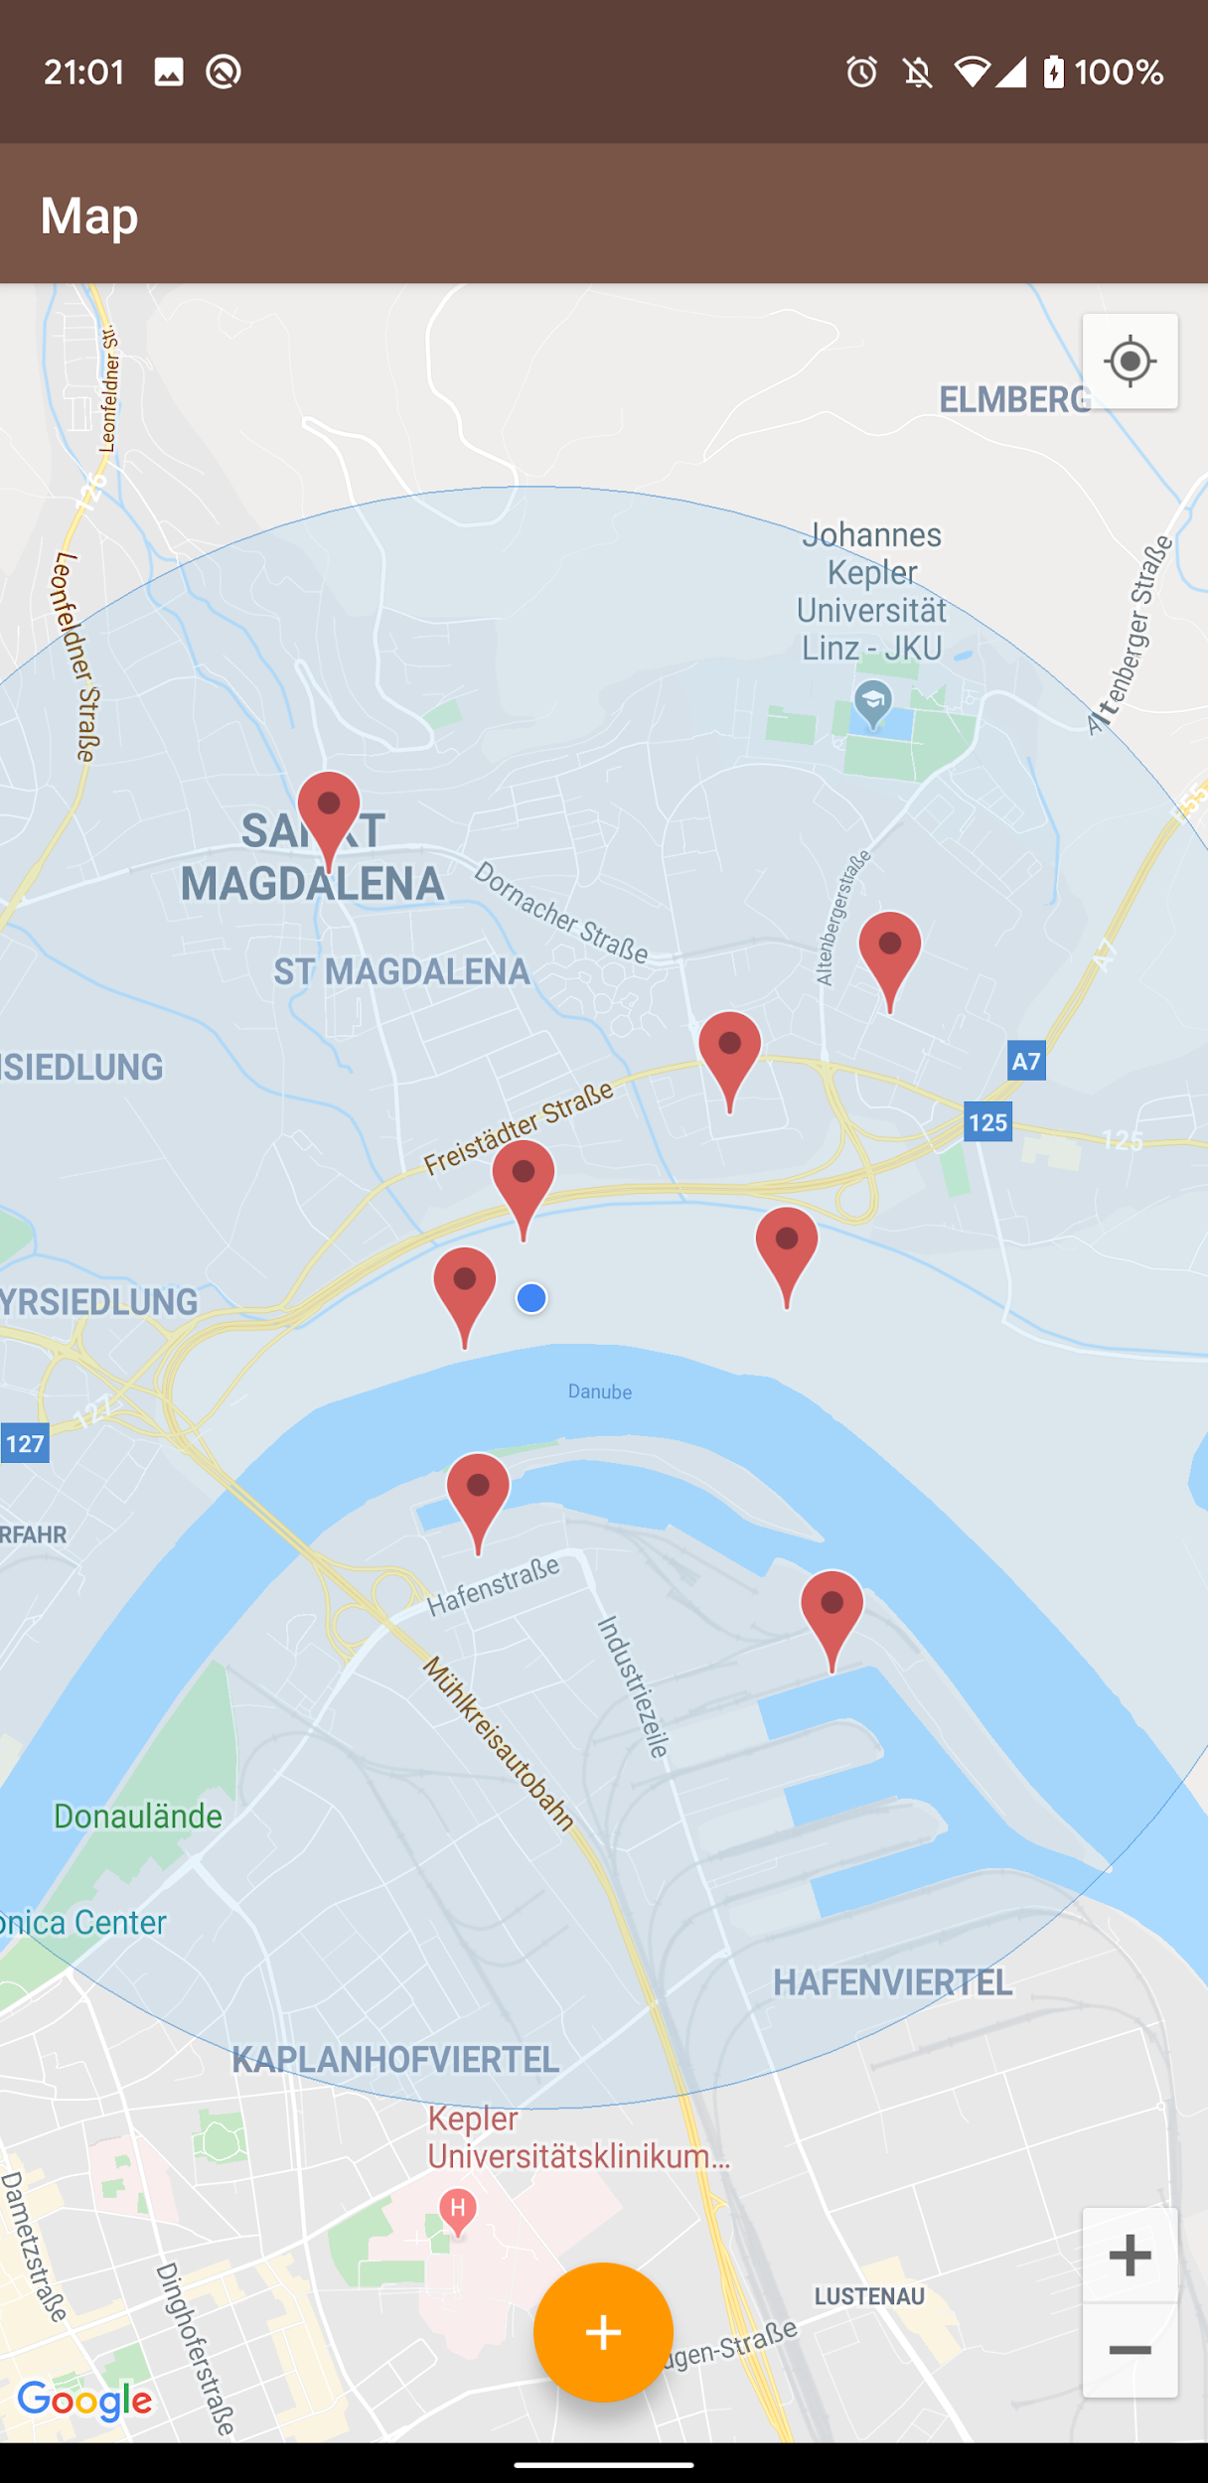
First sketch
Retrieve data about nearby carcasses
Show user’s own position
Provide Button to report new location

Slide 9
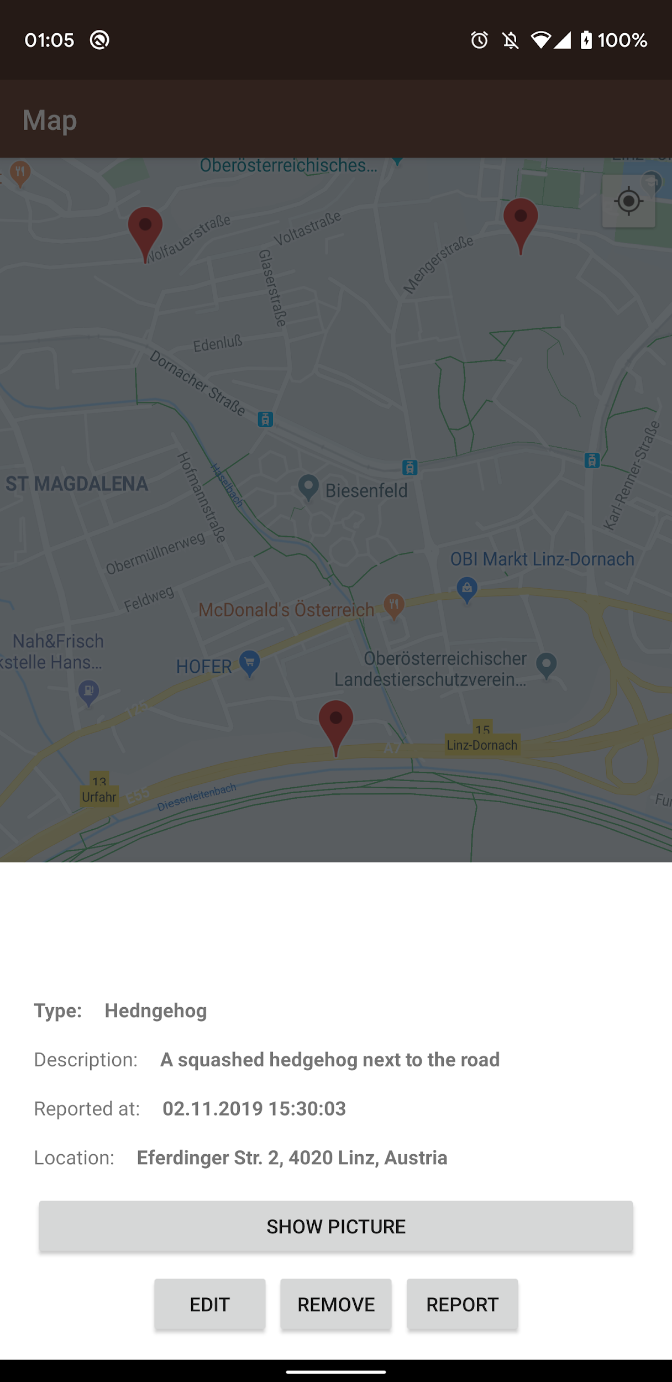
First sketch
On clicking a map marker:
Give more details about the dead animal
Provide possibility for editing information
Report abuse or false information
See picture about incident
Edit existing information
Similar dialog for reporting new locations

Slide 10
Related work
Roadkill (https://roadkill.at/en):
About animals killed on the road only
About statistics and data collection
Account required
No direct contact to authorities
International
Markers do not get removed

Slide 11
Schedule
December 04 - first prototype
December 11 - Mock-up presentation
January 01 - working demo
January 08 - progress discussion
January 22 - release candidate
January 29 - final presentation

Slide 12
Thank you
References and further reading:
https://developer.android.com/studio (Android Studio download site)
https://developer.android.com/ (Development guidelines)
https://developers.google.com/maps/documentation/android-sdk/start (Google maps integration)
https://www.tutorialspoint.com/android/index.htm (Further android development tutorials)
https://console.developers.google.com/ (getting an API key for Maps)

